Slide 1





Cattaraugus & Wyoming Counties
Project Head Start -- CWC-PHS
2018 Year End Report
Presented to the Board of Directors and Policy Council
Be safe - Be respectful - Be a team
empowering families’ well-being, while nurturing and educating children for school and life

Slide 2

This Report Meets the Head Start Act Requirements
Families are the of Head Start
The Head Start Act (section 644(a)(2)) requires each agency to make available to the public at least once in each fiscal year a report that contains eight elements.
  The total amount of public and private funds received and the amount from each source.
  An explanation of budgetary expenditures and proposed budget for the fiscal year.
  The total number of children and families served, the average monthly enrollment (as a percentage of funded enrollment), and the percentage of eligible children served.
  The results of the most recent review by the Secretary and the financial audit.
  The percentage of enrolled children that received medical and dental exams.
  Information about parent involvement activities.
  The agency's efforts to prepare children for kindergarten.
  Any other information required by the Secretary.

Slide 3
The CWC-PHS Audit & Public Information
Great minds begin at Head Start
The 2017 annual independent audit rendered an unqualified audit opinion on the financial statements and compliance for the major federal awards programs. There were no findings and there were no questioned or disallowed costs.
The 2017 annual independent audit determined that CWC-PHS qualifies as a low-risk auditee.
Management reviews its in-kind methodology annually to align with the Uniform Administrative Requirements, Cost Principles, and Audit Requirements for Federal Awards and to meet all Federal requirements.
The results of the 2017 annual independent financial audit were reported to the Board of Directors, shared with Policy Council, and provided to HHS, NYS Department of Health (CACFP) and United Way of Cattaraugus County.
The complexity of the audit increases each passing year, and the cost keeps going up as a result.
IRS 990 is available online thru non Head Start websites or upon request from the agency. https://www.guidestar.org/profile/16-1504738
NYS OCFS day care center licensing information is available online thru non Head Start websites. http://ocfs.ny.gov/main/childcare/looking.asp
Various fiscal and or programmatic reports are filed throughout the year to governmental and non-governmental entities.

Slide 4
A Quick Review of Key Events 2018
Families are the of Head Start
Federal Funding Status
Cost of Living Adjustment – An increase in funding financed a 2.6% across the board pay increase and a small amount for other cost increases.
Costs Skyrocketing - Costs to meet minimum wage, NYS Paid Family Leave, and health insurance continue to increase.
Slot Reduction – Finally, on July 19, 2018 HHS approved the longstanding request to reduce 34 Head Start slots and 8 Head Start jobs in order to balance revenues and expenses.
Information about Head Start
Interested parties may access a wealth of Head Start information online such as the Act, rules, policy, and learning materials and resources at the Early Childhood Learning & Knowledge Center https://eclkc.ohs.acf.hhs.gov/
Reviews
There were no Federal reviews in 2018. HHS monitored enrollment. Once again, the federal review system is being rebuilt.
NYS OCFS conducted mulitple reviews of all sites throughout the year.
Other Grants and Programs
PEDALS - Supported by the Blue Fund – Community Connections of New York, Inc.,- Health Foundation for Western and Central New York;. PEDALS is a proven model for improving social and emotional development in preschoolers; CWC-PHS will be expanding the program and services in the southern tier in 2019.
SLEEP – After years of planning, with UCLA & Einstein College, this research project provided Sleep Literacy -SweetDreamzzz training to staff, parents and all Head Start children.
HEALTH CARE INSTITUTE – Parents were trained in promoting oral health in young children in 2018..
HEALTHY START 2021 – An effort resulting from Building Healthy Community Partnership program; about employee wellness.

Slide 5
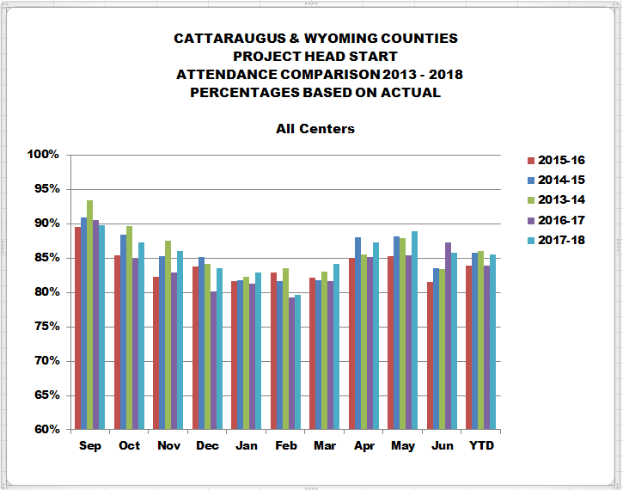
386 children and 345 families served in Head Start & Early Head Start
Great minds begin at Head Start
2017-2018 Data on Children Served & Families
Head Start - 282 slots A total of 325 children were enrolled from 293 families with 51% being single-parent families (was 44% last year). Issues of low end of month enrollment have been resolved although maintaining full enrollment is challenging especially in UPK or four year old classes. 9 children were homeless (down from 14 last year). 27 were considered over income, (down from 32 last year). 191 or 59% were below the federal poverty level (up from 56% last year).
Early Head Start - 50 slots A home based program. 61 children and 6 pregnant women from 52 families enrolled with 40% as single-parent families (up from 35% last year). 4 children were homeless (down from 7 last year) and 1was considered over income; 60% were below the federal poverty level (was 57% last year).
There are unserved eligible children. The 2016 community assessment showed virtually no change from the 2013 edition in terms of the number of potentially eligible children. Head Start serves only 18.9% of those potentially income eligible (virtually unchanged since 2013 @ 18.6%) and Early Head Start serves 2.0% of those potentially income eligible (no change from 2013).
Attendance Rates - Good
The average daily attendance increased
to 84.14% based on funded enrollment (up from 78.6% last year) and 85.75% based on actual enrollment. (up from 83.4% last year).

Slide 6

Student Outcomes - Child Observation Record children continue to make significant gains
Families are the of Head Start
CWC-PHS uses HighScope’s OnlineCOR, Child Observation Record to manage assessment tasks, and entering anecdotes to produce reports, including Head Start Outcomes, state standards, and more. The Child Observation Record (COR), is internationally known as an authentic, research-validated, observation based assessment tool.
In 2017-18, the student outcomes or rates of gain for the eight domains measured during the year were significant; only one indicator (science) regressed. Overall two improved and two were unchanged from prior year. Every year is different depending on the age of the children, when they enter, etc.

Slide 7
Challenges for 2018-2019 and Beyond
Great minds begin at Head Start
New Challenges for 2018-2019 include:
Sleep Study Implementation & Health Care Institutes
NYS QualityStars – maximize the benefits of participation in this accreditation like program to satisfy new Head Start and NYS rules
NYS OCFS Child : Staff Ratios on busses – additional personnel needed; limits capacity
Into the Future, the Challenges include:
Changing Landscape – NYS continues to increase its UPK efforts; now allowing three year olds and building of classrooms for pre-k on the cheap (no local share)
Wages – The annual increases in NYS minimum wage continues to strain the budget and ‘compress’ the pay scale; and the NYS unfunded mandate to pay registered voters to vote
Diversify Revenue – operating support programs and activities with non- federal Head Start funding such as expansion of the PEDALS project into a HUB for other agencies’ classrooms; Health Care institute focused on trauma and Success By Six initiatives. NAEYC Accreditation – CWC-PHS continues to maintain accreditation at all locations
Continued micro-management of local grantees by HHS Central (DC) and Regional Office and Training Providers
Affording Health Insurance – the cost of providing health insurance continues to outpace budget growth and affordability
Study Program Realignment – slot conversion, slot allocation among classrooms, possible elimination of duration requirement and what if ‘free classroom space’ at elementary schools goes away?

Slide 8
An Explanation of 2018 Budgetary Expenditures & Proposed Budget for 2019
Families are the of Head Start
A detailed explanation of budgetary expenditures is included in our HHS grant application(s) which are subsequently approved by HHS. The table below is a summary. All costs are reasonable, necessary and allocable.
The Board of Directors and Policy Council reviewed and approved 2018 Head Start & Early Head Start grant applications. Relevant correspondence and program information is provided to the governing bodies.
Key factors driving up costs for 2018 were health insurance and the minimum wage increase.
Proposed Head Start slot reduction to save and redirect resources.
The 2019 budget is similar to 2018.

Slide 9
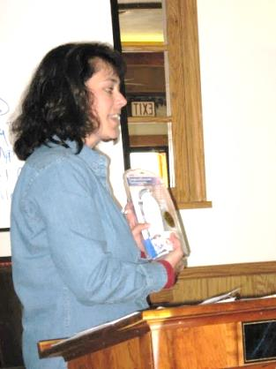
Meeting the Matching Requirement it is getting harder
Great minds begin at Head Start
CACFP – Child and Adult Care Food Program – is from the NYS Department of Health, reimbursement for meals and snacks served. Applications are filed annually. CACFP is not a part of non federal share.
Met Non-Federal Share requirements & Under Administrative Limit - The agency recorded more than $984,429 – satisfying the required non-federal share / in-kind for 2018.
Private Funds Received - non Head Start | 2018 | 2017 | 2016 | 2015 | 2014
CACFP - Food Program | $ 186,129 | $ 180,287 | $ 185,917 | $ 176,847 | $ 168,253
Non-Federal - Cash (i.e., UPK) | $ 153,473 | $ 151,170 | $ 152,744 | $ 151,204 | $ 166,171
Non-Federal - Donated Goods & Services | $ 832,500 | $ 812,873 | $ 674,245 | $ 877,140 | $ 924,028
Total Agency Revenue | 2018 | 2017 | 2016 | 2015 | 2014
Head Start (basic) | $ 3,253,548 | $ 3,189,880 | $ 2,919,708 | $ 2,866,481 | $2,908,049
Head Start - Training | $ 32,012 | $ 30,924 | $ 30,924 | $ 31,577 | $ 32,035
Early Head Start (basic) | $ 631,344 | $ 611,290 | $ 605,564 | $ 596,453 | $ 605,102
Early Head Start - Training | $ 15,731 | $ 14,675 | $ 14,681 | $ 14,034 | $ 14,238
One Time Only Head Start Grants & Muisc. | $ 59,295 | $ 79,186 | $ 96,920 | $ - | $ -
TOTAL | $ 5,164,032 | $ 5,070,285 | $ 4,680,703 | $ 4,713,736 | $4,817,876

Slide 10
CWC-PHS’s Efforts to Prepare Children for Kindergarten – the School Readiness Plan
Families are the of Head Start
  Head Start and Early Head Start curriculums align with UPK program(s), NYS standards, and HS framework / new regulations
  Coordinate with kindergarten screenings
  Systemic and individualized transition plans and communications with kindergarten teachers
  CWC-PHS ‘School Readiness Plan’ for birth to school age
  CWC-PHS Parent, Family, and Community Engagement Framework plan
  Maintain the non-financial agreements in place with all area school districts as required by the HS Act
  Newsworthy notes to parents; encourage attendance
  Parent involvement and education; parent – teacher conferences & home visits
  Providing families with a summer activity kit
  Providing, under contract, NYS UPK to various school districts
  Structured and intentional approach to child development and individualized instruction using Pyramid Model
  CWC-PHS use of HighScope’s Program Quality Assessment (PQA) for classroom observation & continuous improvement & professional development

Slide 11
Medical & Dental Outcomes – Head Start
Great minds begin at Head Start
Modest increase in percentage of overweight and obese children
Increase in percent of children up to date with preventive care
Percentage of children with disabilities is almost double the minimum required

Slide 12
Medical & Dental Outcomes – Early Head Start
Families are the of Head Start
SNAP percentage declined drastically
All needing medical treatment go it e
Six (6) pregnant women were served (4 second trimester, 2 third trimester)
Slight increase in WIC participation

Slide 13
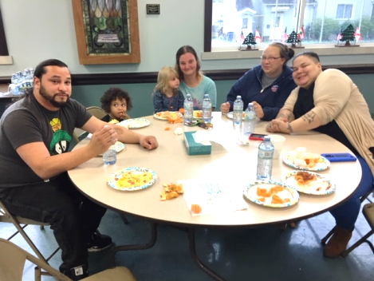
Parent Involvement Activities
Increase in Parent Volunteers
Great minds begin at Head Start
Activities included: Cornell Cooperative Extension trainings, Parent Orientation, Policy Council and Board Training, FlipIt, Family – Reading Nights, First-Aid, Crafts, FlipIt, Parent Committees, Fatherhood Initiatives - Breakfast of Champions & Gentlemen’s Luncheon; Mother’s Day Tea & Mother’s Breakfast and Cavity Free Kids.
Head Start had 766 total volunteers down about 20% from prior year; 64% of the volunteers were current or former HS or EHS parents.
Early Head Start had 117 total volunteers up 20% from prior year; 92 or 79% were current or former HS or EHS parents.
Policy Council remains a cornerstone of parent involvement.
The time parents spend on at home classroom related activities is significant.
The 2017-18 parent end-of-year parent evaluations are very positive and are summarized below.

Slide 14
Parent Evaluations – evidence of quality keeping the customers satisfied five years of data
Families are the of Head Start
PARENT EVALUATIONS - END OF THE YEAR COMPARISONS 2013-10 thrugh 2017-18 | Head Start % of Respondences who Said Yes |  |  |  |  |  | Early Head Start % of Respondents who Said Yes
 | 2013-14 | 2014-15 | 2015-16 | 2016-17 | 2017-18 | AVG | 2013-14 | 2014-15 | 2015-16 | 2016-17 | 2017-18 | AVG
Do you feel welcome at Head Start? |  | 98.3 | 99.0 | 100 | 100 | 99%
Do you feel that your child is safe at Head Start? | 100 | 100 | 99.0 | 100 | 98.2 | 99%
Do you feel that HS helped to prepare your child for kindergarten? (preschool for EHS) | 98.9 | 99.12 | 97.96 | 100 | 99.1 | 99% | 100 | 100 | 100 | 100 | 100 | 100%
Has your knowledge of child development increased because of HS? | 91 | 87.61 | 86.6 | 91.38 | 97.25 | 91% | 100 | 97.22 | 94.44 | 100 | 100 | 98%
Were the home visits by your child's teacher helpful to you? | 90.8 | 91.67 | 85.42 | 92.98 | 91.5 | 90%
Has our staff stressed to you the importance of regular attendance for school success? |  | 92.24 | 92.71 | 93.1 | 97.2 | 94%
Has Head Start staff shared the results of health and developmental screenings with you? |  | 94.5 | 93.6 | 96.2 | 97.22 | 95%
If your child received services through MH Consultants, or CPSE, has HS staff assisted you with the process? |  | 92.5 | 72.2 | 76.5 | 83.7 | 81%
Has HS's meal service been a positive experience? | 98.9 | 96.46 | 95.92 | 93.33 | 97.3 | 96%
Family Partnership Agreements - did your FSA/FDS help establish a goal for you/family? | 93 | 93.07 | 85.1 | 94.7 | 90.2 | 91% | 100 | 93.6 | 100 | 96.9 | 100 | 98%
If so, did you work toward accomplishing that goal? | 92.8 | 97.85 | 84.9 | 96.3 | 97.8 | 94% | 97.2 | 93.3 | 96.9 | 100 | 100 | 97%
If so, did you achieve all or part of your goals? | 89.7 | 85.39 | 87.4 | 90.6 | 90.3 | 89% | 94.3 | 90 | 80.7 | 83.3 | 92.9 | 88%
Did you participate in EHS socializations? |  |  |  |  |  |  | 64.9 | 58.8 | 63.9 | 69.7 | 51.5 | 62%
Did your EHS Family Development Specialist provide appropriate activities for home visits? |  |  |  |  |  |  | 100 | 100 | 100 | 100 | 100 | 100%
Did your EHS Family Development Specialist ask for your input in planning home visits? |  |  |  |  |  |  | 100 | 100 | 100 | 97.0 | 100.0 | 99%
Has EHS had a positive effect on your child's health/mental health? |  |  |  |  |  |  | 100 | 100 | 100 | 100 | 100.0 | 100%
Has EHS had a positive effect on your family's health/mental health? |  |  |  |  |  |  | 100 | 100 | 100 | 100 | 100 | 100%
Overall, how was your EHS / HS experience? (Excellent and Good) |  |  |  |  | 100 | 100% |  |  |  |  | 100 | 100%
Health as reason chuild missed school |  |  |  |  | 83.6 | 84%
Have you visited our Facebook page? |  |  |  |  | 60.2 | 60%

Slide 15
According to the Act
Providing Board & Policy Council Information
Great minds begin at Head Start
CWC-PHS ensures the sharing of accurate and regular information for use by the
governing body and the policy council, about program planning, policies, and Head Start agency
operations, including:
(A) monthly financial statements, including credit card expenditures;
(B) monthly program information summaries;
(C) program enrollment reports, including attendance reports for children whose care is partially subsidized by another public agency (not applicable);
(D) monthly reports of meals and snacks provided through programs of the Department of Agriculture;
(E) the financial audit;
(F) the annual self-assessment, including any findings related to such assessment;
(G) the communitywide strategic planning and needs assessment of the Head Start agency, including any applicable updates;
(H) communication and guidance from the Secretary; and
(I) the program information reports.
The agency’s self-assessment is based on the three established goals as set forth in the five year grant.

Slide 16

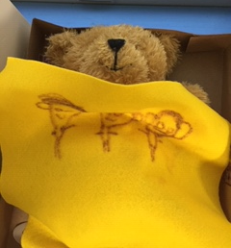
Any Other Information Required by the Secretary
Families are the of Head Start
To the best of our knowledge, there is no other information required.
The CEO - Head Start Director continues to serve on the NYS Early Care Advisory Council having been appointed by the Governor to be a member and represent the NYS Head Start Association in 2009.
The official Head Start Enterprise System’s (HSES) reach is ever increasing; now used to track official correspondence for example and to sweep newspapers across America to find Head Start stories and direct them to appropriate Regional Office staff.

Slide 17
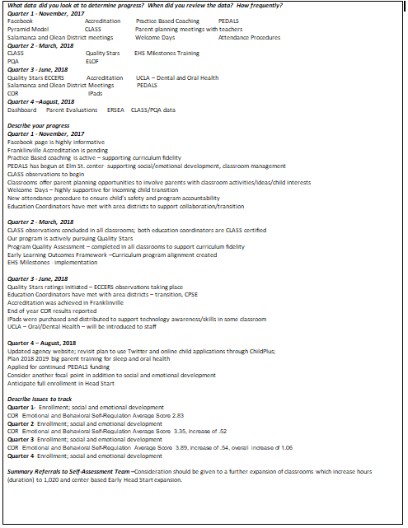
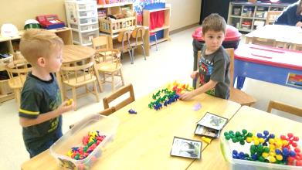
Great minds begin at Head Start
2017-2018 Self-Assessment Early Childhood and School Readiness Operations Committee

Slide 18
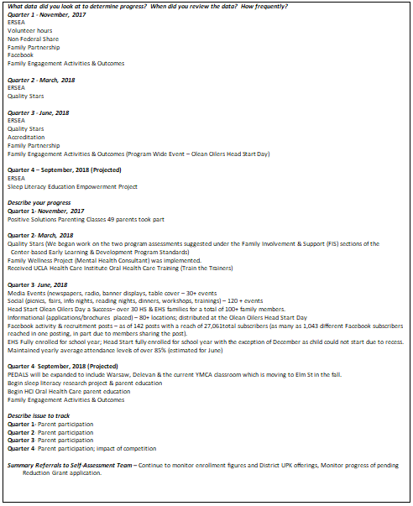

2017-2018 Self-Assessment Communications & Community Engagement Operations Committee
Families are the of Head Start

Slide 19
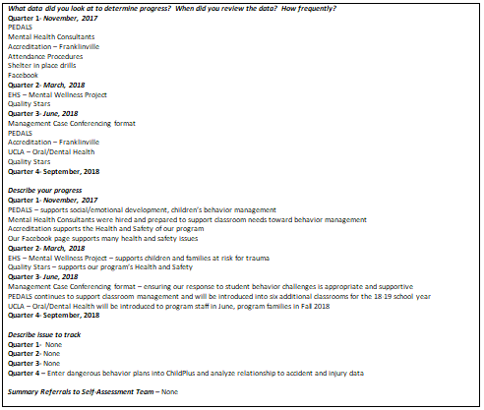
Great minds begin at Head Start
2017-2018 Self-Assessment Health and Safety Operations, Health Services Advisory, Administration Committees

Slide 20




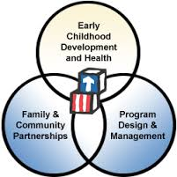
Families are the of Head Start
The Results of the Most Recent Review by HHS
….the Secretary
Independent Audit. To extent allowed by law, policy and procedure a copy of the independent audit report may be obtained by requesting it in writing from the agency’s Financial Manager at Head Start, 101 South 19th Street, Olean NY 14760.
There was no federal onsite review conducted.

